Slide 1
Guidelines for procurement of Fodder Preservation and Processing Equipment
Hay & Silage
Prepared by:
Odida Daniel Comboni
Programme Officer – Livelihoods, DRR & Livestock

Slide 2
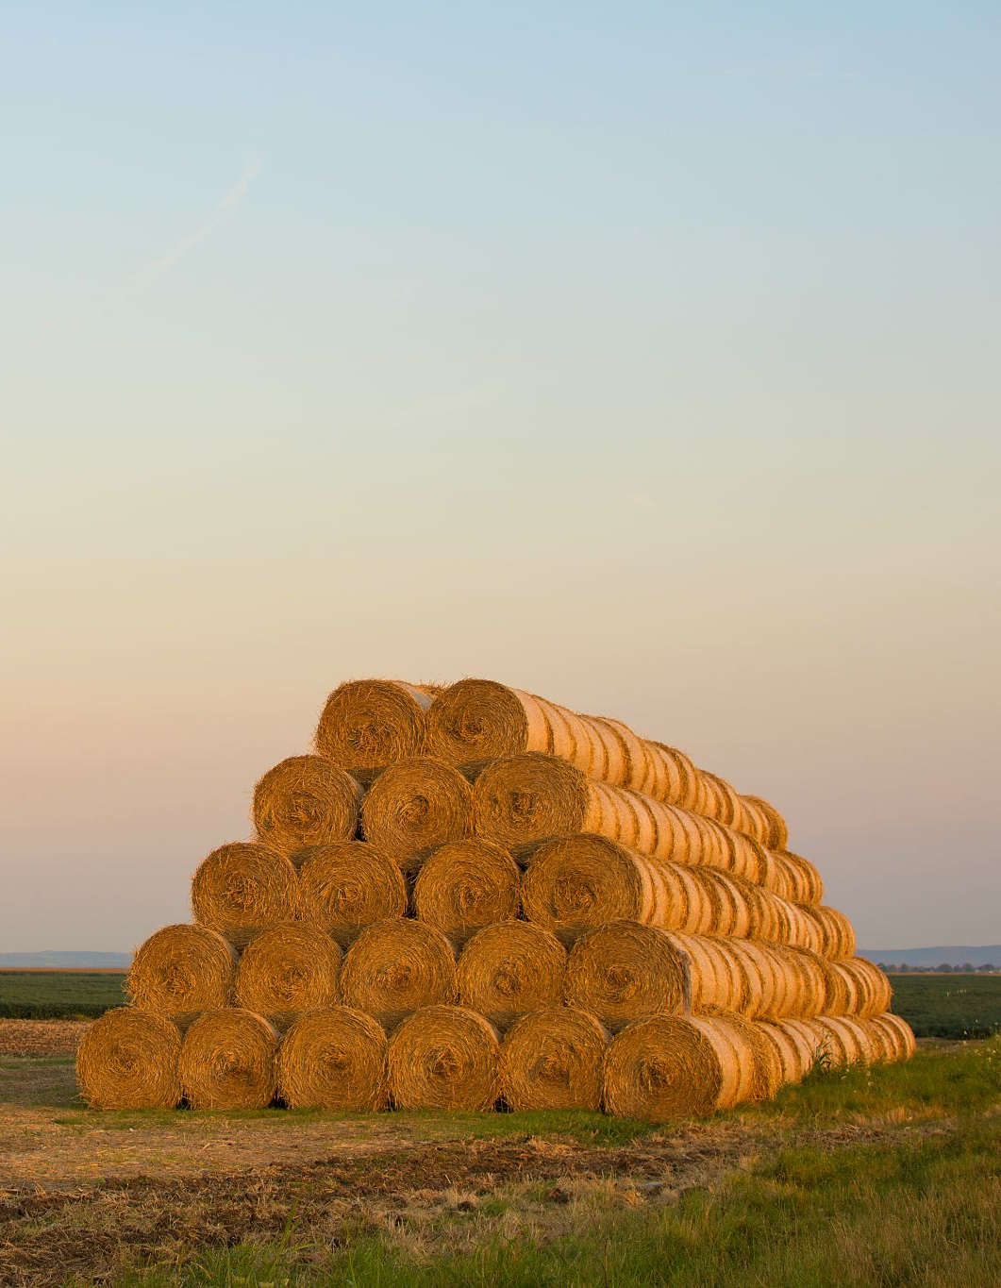
HAY BAILING
1. Bale Sizes
The size of the bale depends on the type of baler being used and the specific needs of the farm. Common bale measurements include:
Small Square Bales:
Dimensions: Typically, 14–16 inches in height, 18–24 inches in width, and 36–42 inches in length.
Weight: Typically ranges from (18 to 34 kg), though it can vary based on hay type and moisture content.

Slide 3
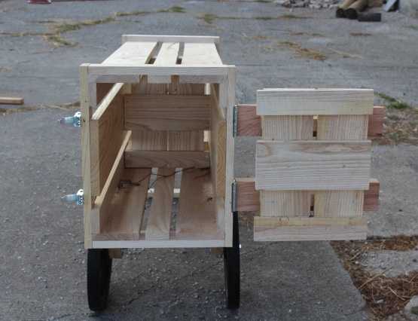
Wooden Hail Baler
Bale Size and Weight:
Bale Weight: 50 kg (approximately 110 lbs)
Bale Type: Square or rectangular bale
Bale Dimensions:
Length: Typically, around 90–120 cm (35–47 inches)
Width: 35–45 cm (14–18 inches)
Height: 30–40 cm (12–16 inches)

Slide 4
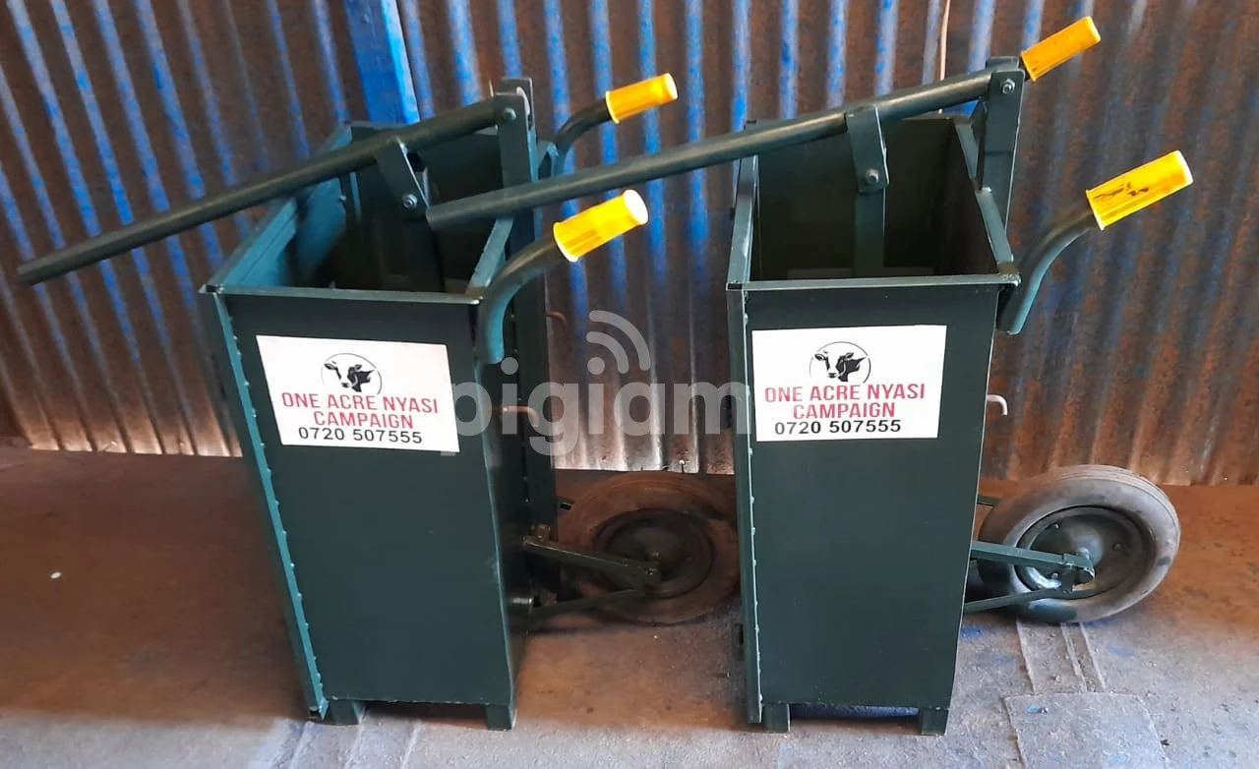
Metallic Hay Bailer

Slide 5
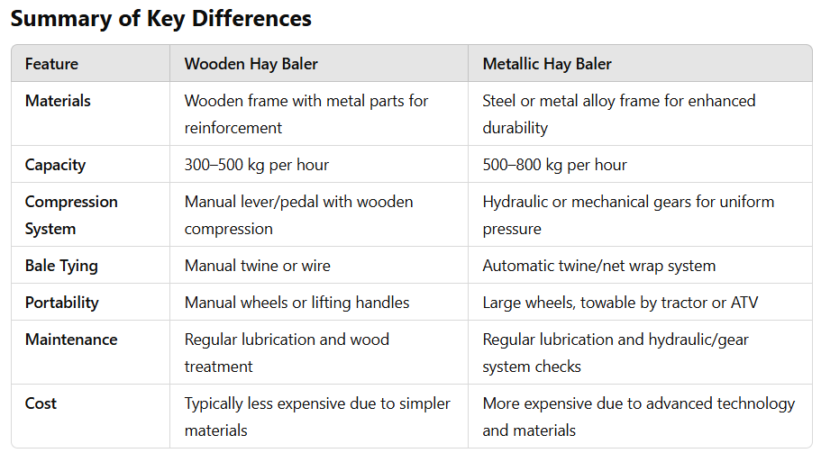

Slide 6
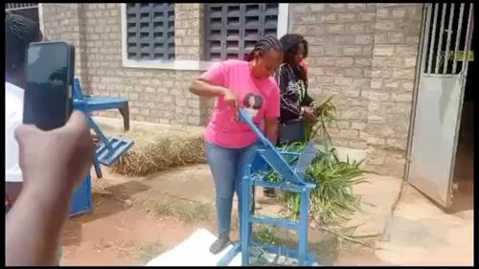

Slide 7
Chaff cutter for Silage making
Manual Chaff Cutters: These are hand-operated machines that require physical effort to chop the fodder. They are typically used for smaller farms or where feed requirements are limited.

Slide 8
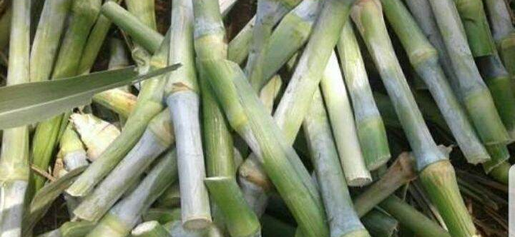
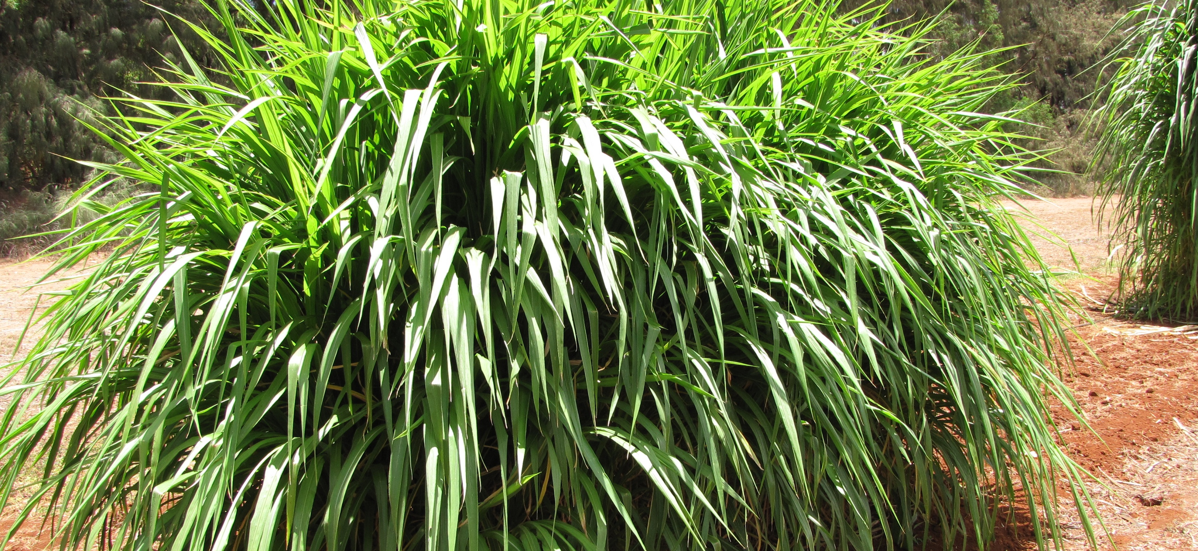
Napier Grass Cuttings

